Slide 1



Study of existing solutions
Aslene Ouaze

Slide 2
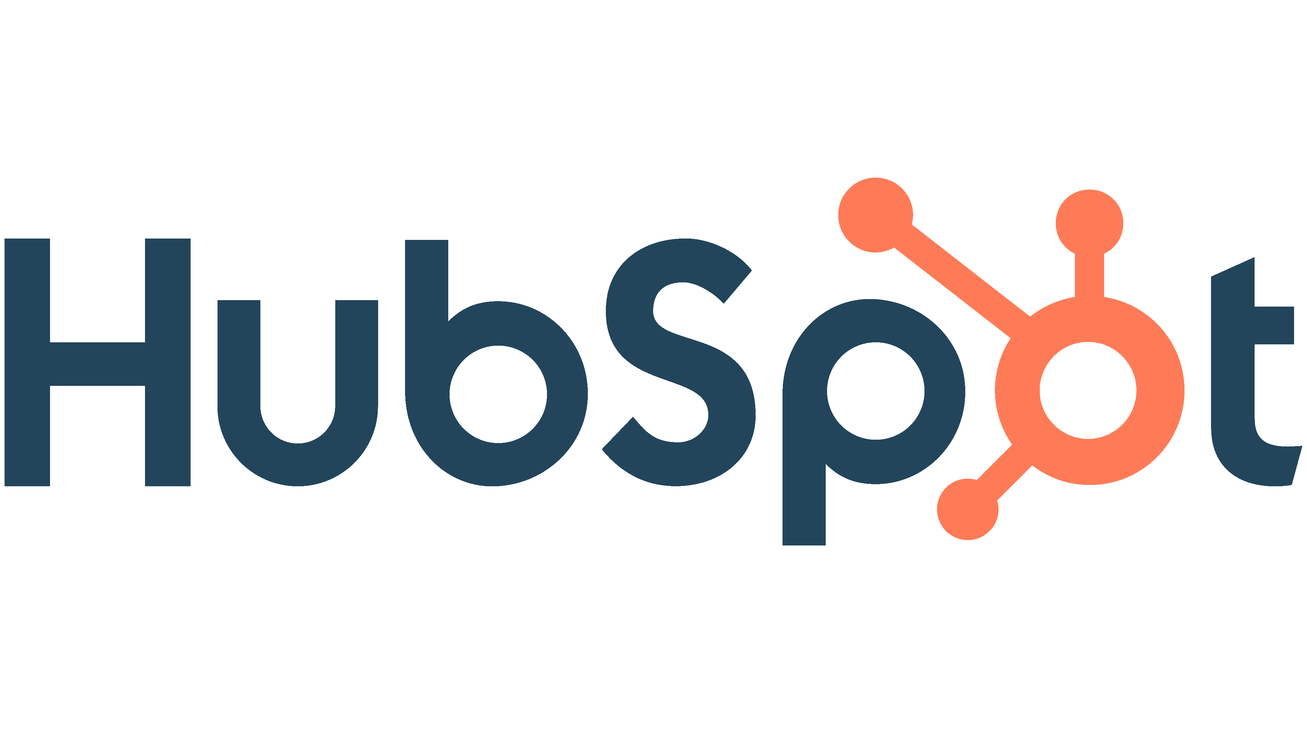
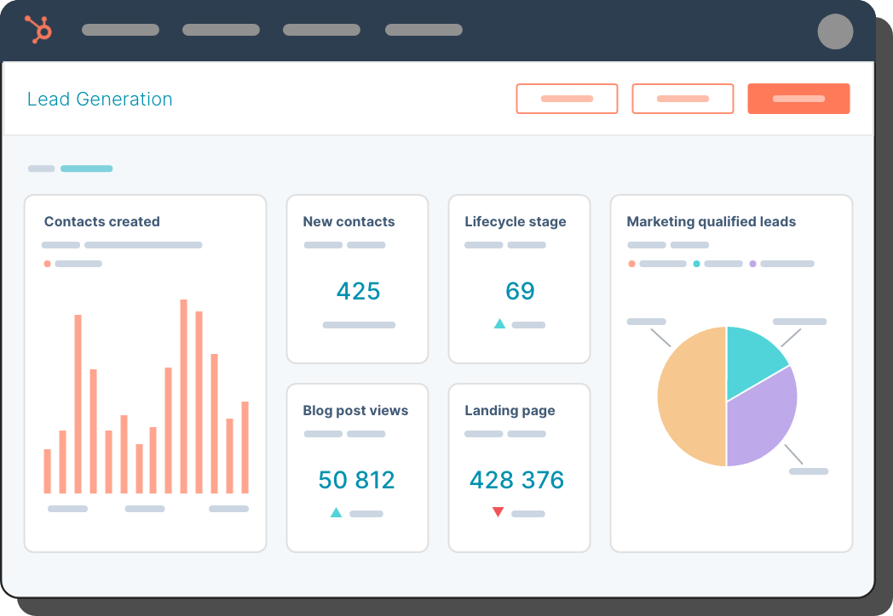
HubSpot
HubSpot is a popular marketing, sales, and customer service platform that integrates with Salesforce.
HubSpot uses Salesforce's user management features to allow organizations to manage their teams and control access to different parts of the application.

Slide 3
HubSpot
(+) Pros:
User-Friendly Interface: HubSpot's user interface is designed to be user-friendly, making it easy to manage user accounts, roles, and permissions. This helps businesses save time and increase efficiency when managing users.
Role-Based Access: HubSpot's role-based access control allows businesses to create custom roles and assign specific permissions to users based on their roles. This ensures that users only have access to the tools and data they need to do their jobs effectively.
User Activity Tracking: HubSpot tracks user activity, allowing businesses to monitor user behavior and ensure compliance with company policies and regulations.
(-) Cons:
Complexity: While HubSpot's user management interface is user-friendly, it can be complex, particularly for businesses with a large number of users. This may require more time and effort to manage and configure.
Cost: HubSpot's pricing structure is based on the number of contacts in a business's database, which can make it more expensive for businesses with larger teams. This may be a concern for businesses with many users who require access to HubSpot's tools and features.
Learning Curve: For businesses new to HubSpot, there may be a learning curve when it comes to managing users and configuring access control. This may require additional training or resources.

Slide 4
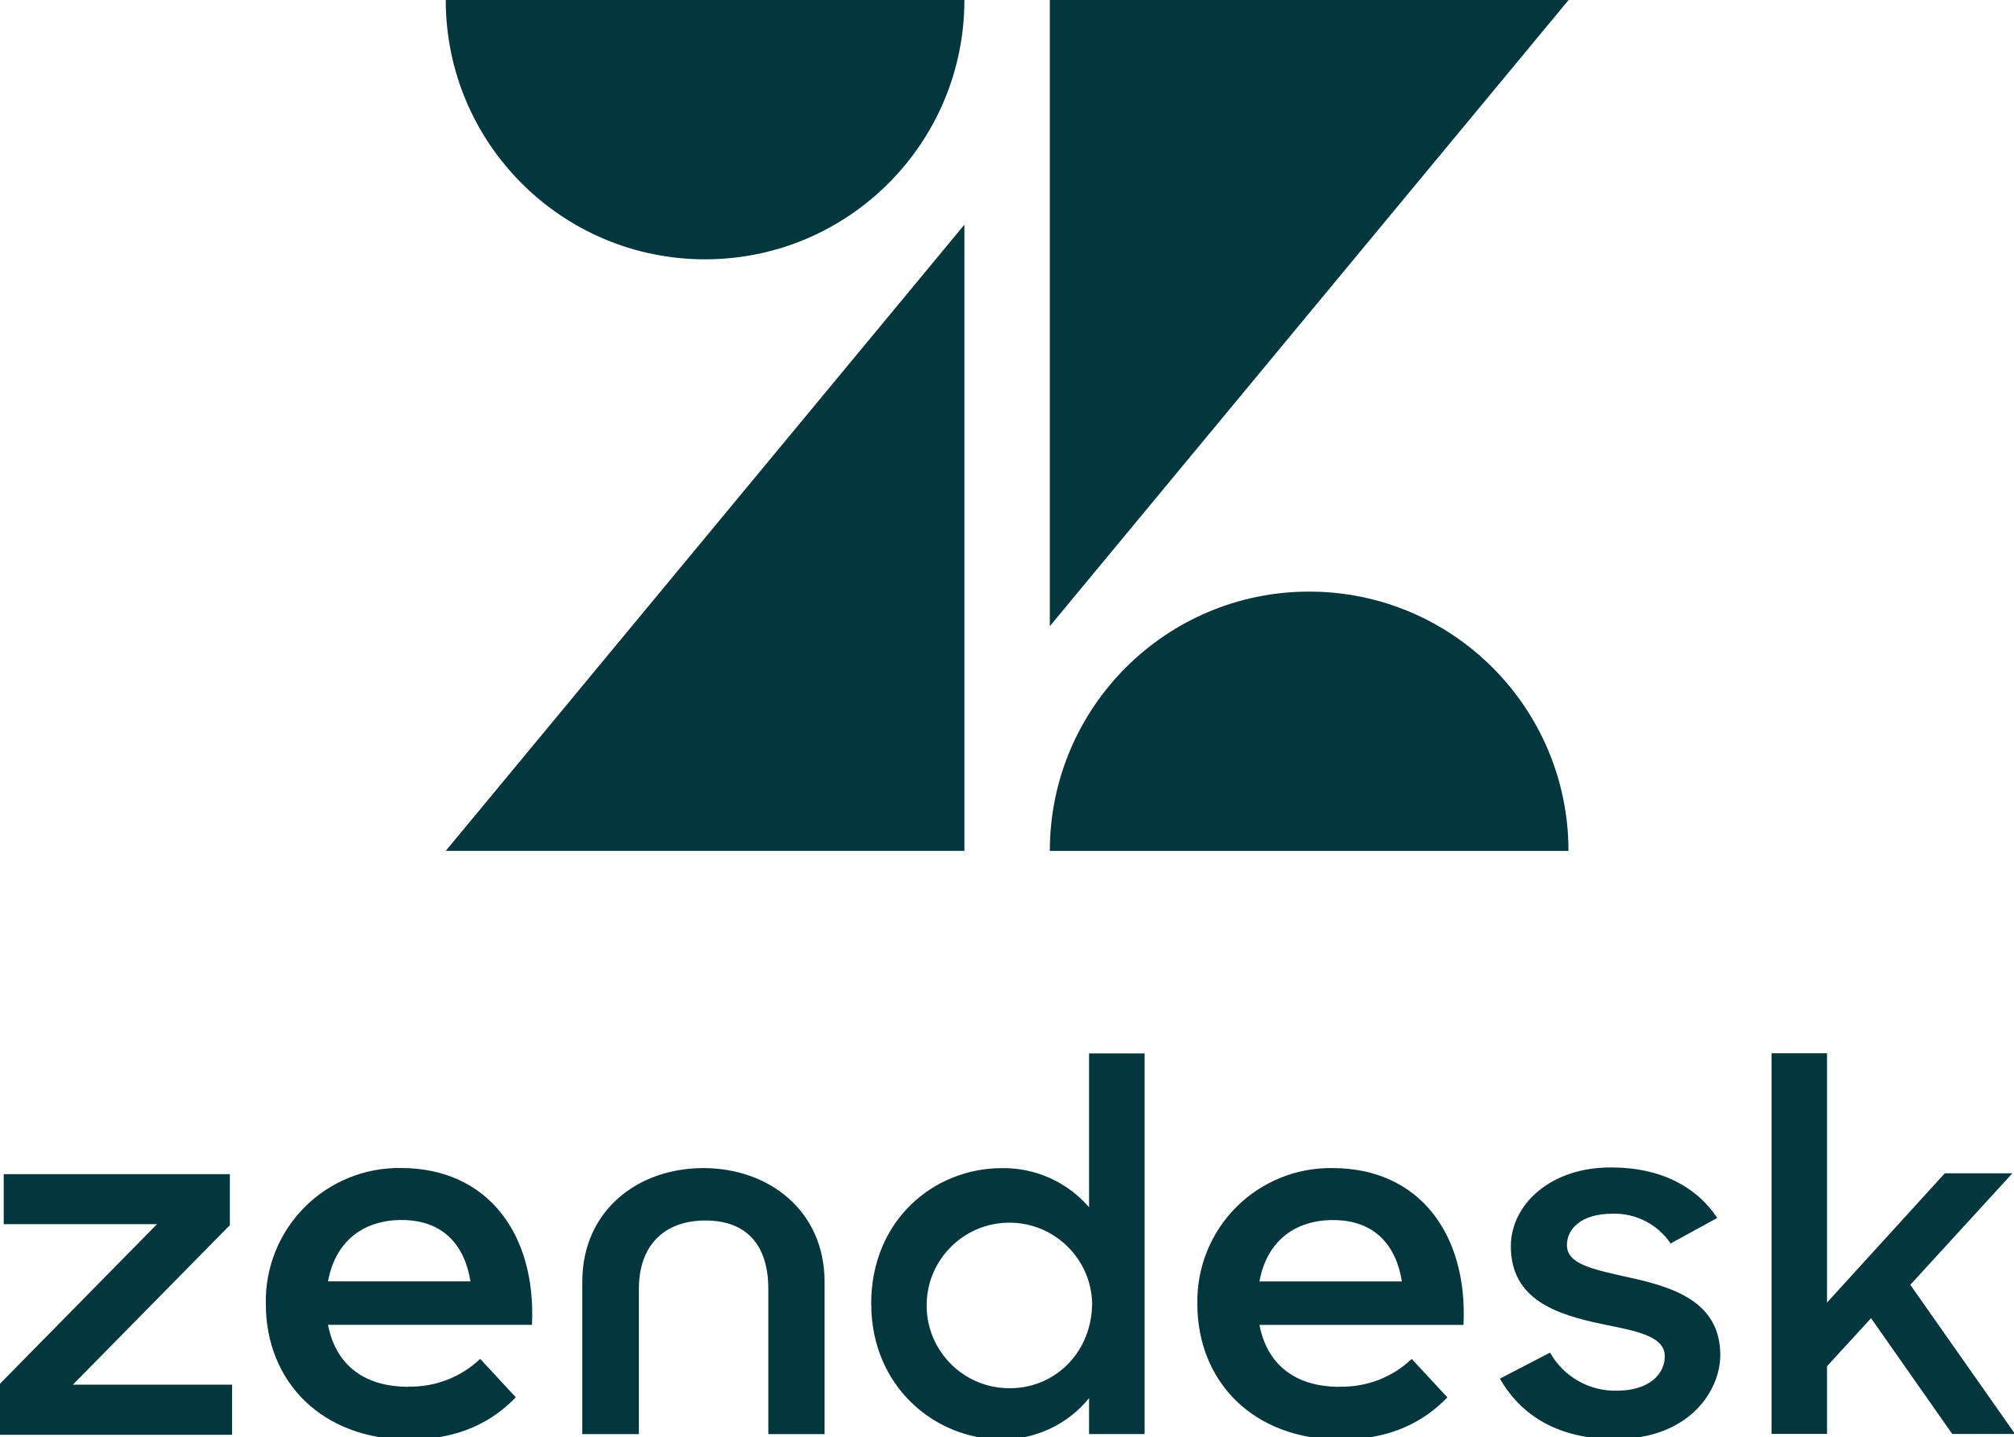
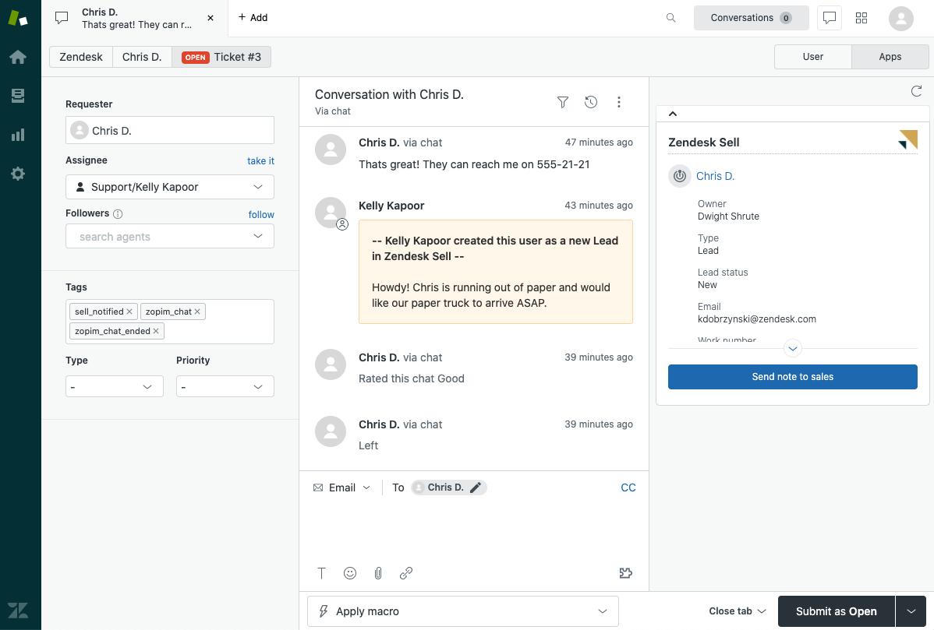
ZenDesk
ZenDesk is a customer support platform that integrates with Salesforce.
ZenDesk uses Salesforce's user management features to allow organizations to manage their support teams and control access to different parts of the application.

Slide 5
ZenDesk
(+) Pros:
User Analytics: Zendesk provides user analytics, allowing businesses to monitor user behavior and identify areas for improvement in the support process.
Customizable Notifications: Zendesk allows businesses to set up custom notifications for user actions, such as ticket creation or update. This helps ensure that teams stay informed and can take action quickly.
User Collaboration: Zendesk provides tools for user collaboration, such as shared views and comments, allowing teams to work together more efficiently.
(-) Cons:
Limited Permissions: Zendesk's role-based access control may not offer as much granularity as some businesses require. For example, it may not be possible to create custom permissions for individual users or specific tasks.
Limited Customization: While Zendesk's user interface is user-friendly, it may not offer as much customization as some businesses require. This may be a concern for businesses with specific branding or customization requirements.
Cost: Zendesk's pricing structure is based on the number of agents, or users who interact with customers, which can make it more expensive for businesses with larger teams. This may be a concern for businesses with many users who require access to Zendesk's tools and features.

Slide 6
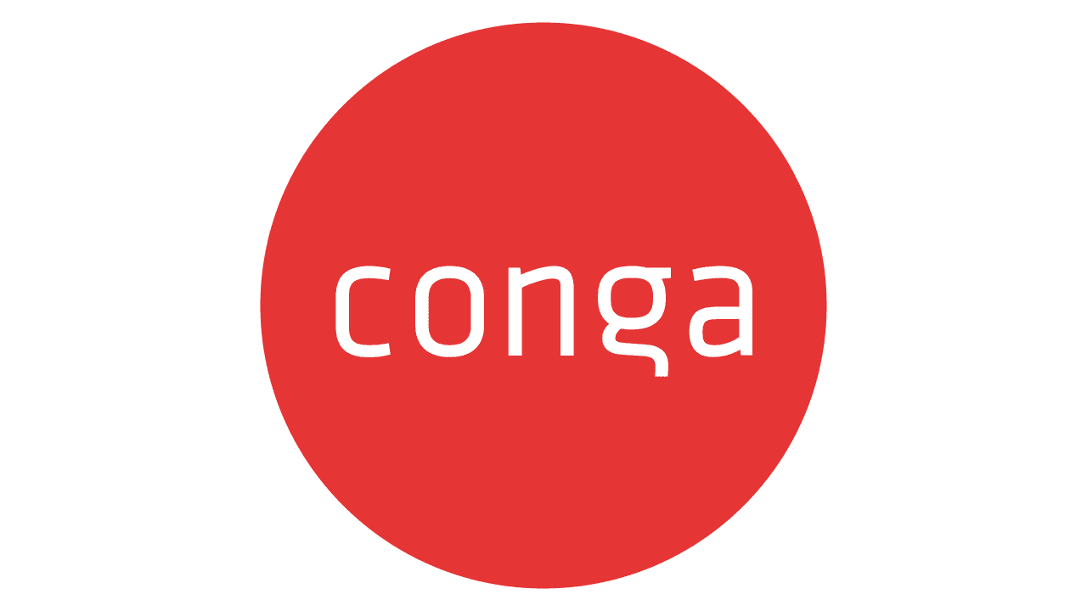
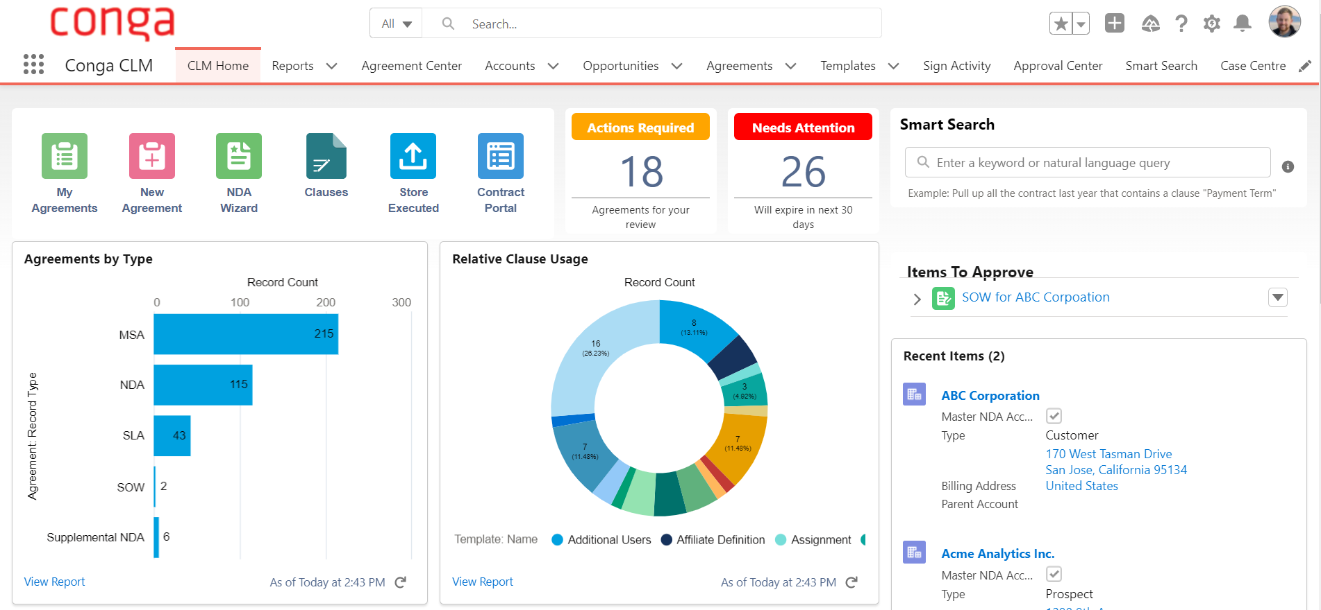
Conga
Conga is a document generation and reporting platform that integrates with Salesforce.
Conga uses Salesforce's user management features to allow organizations to manage their teams and control access to different parts of the application.

Slide 7
Conga
(+) Pros:
Customizable Workflows: Conga offers customizable workflows, allowing businesses to automate document creation and approval processes and ensure that documents are routed to the right people at the right time.
Centralized User Management: Conga provides a centralized user management system, allowing businesses to manage all their users from one central location. This saves time and ensures consistency across the organization.
Collaboration Tools: Conga provides tools for user collaboration, such as document sharing and commenting, allowing teams to work together more efficiently.
(-) Cons:
Limited Integrations: While Conga integrates with several third-party applications, some businesses may require integrations with more specialized tools or systems, which may not be available.
Cost: Conga's pricing structure can be more expensive for businesses with larger teams. This may be a concern for businesses with many users who require access to Conga's tools and features.
Complexity: Conga's user management interface can be complex, particularly for businesses with a large number of users. This may require more time and effort to manage and configure.

Slide 8

THANK YOU

